Slide 1
Business Intelligence: Introduction and the “BI Stack”
IS201 – 2020-03-02 - Prof Redd

Slide 2
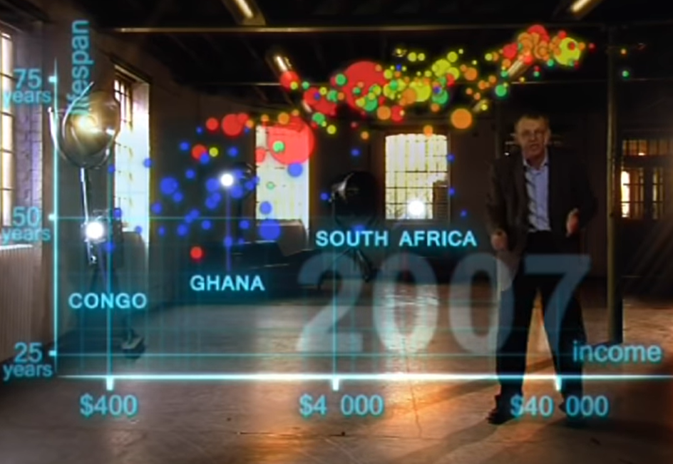
Hans Rosling – Data Visualization
BBC4 – Hans Rosling – 200 Countries, 200 Years, 4 Minutes https://www.youtube.com/watch?v=jbkSRLYSojo
Notes:
Sadly, Rosling passed away in 2017.

Slide 3
Upcoming Schedule
In-Class
Today: Introduction to Business Intelligence and Data Mining (Chapter 5)
Monday 3/9: Prof Redd in Washington D.C. Data Conference Practice Tableau with Tas
Wednesday 3/11: Begin Work with Tableau
Homework and Exam
Today: Olympus Tours Due (Unit 4.6)
Saturday 3/7: VBA Programming Midterm Due (Unit 4.8)
Check the review materials from Monday!
Sometime this week, download and install Tableau (instructions on LearningSuite schedule)

Slide 4
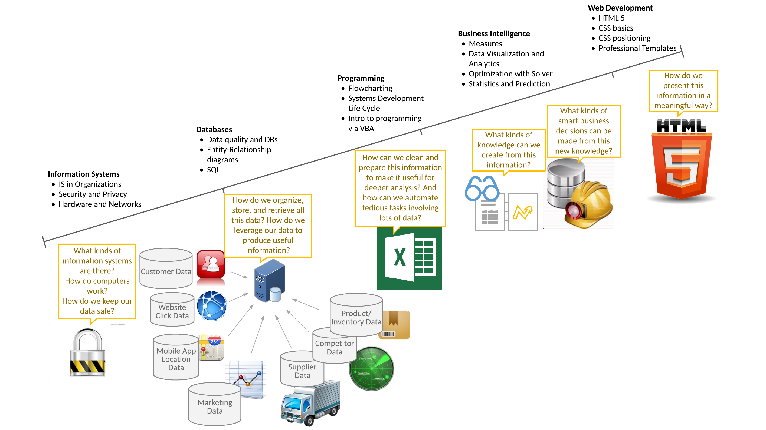

Slide 5
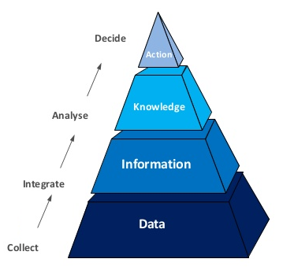
Business Intelligence
The collection and organization of data into information that informs good decision making. (Brandt Redd)
The procedural and technical infrastructure that collects, stores, and analyzes the data produced by a company’s activities. (Investopedia)
The strategies and technologies used by enterprises for the data analysis of business information. BI technologies provide historical, current and predictive views of business operations. (Wikipedia)

Slide 6

Observations
People in the Pacific Northwest are low on Vitamin D.
Pacific Northwest has high rates of Multiple Sclerosis, Skin Cancer, Heart Disease, and Depression.
Sun Exposure is low in the Pacific Northwest due to weather and short winter days.

Slide 7
Find Competing Plausible Causes
Multiple plausible reasons typically exist for each outcome
Unless you identify plausible reasons, you don’t know what to measure
Your job is to find testable hypotheses

Slide 8
Hypothesis
Low levels of Vitamin D are due to reduced sun exposure.
Health issues may be due to low Vitamin D.
These assertions can be tested!

Slide 9
Assumptions vs. Hypotheses
An assumption is a reasonable explanation
that will not be tested, and
that usually cannot be supported or rejected based on available evidence.
A hypothesis is a reasonable guess
that can be tested, and
that can be supported or rejected based on available (or collectable) evidence.

Slide 10
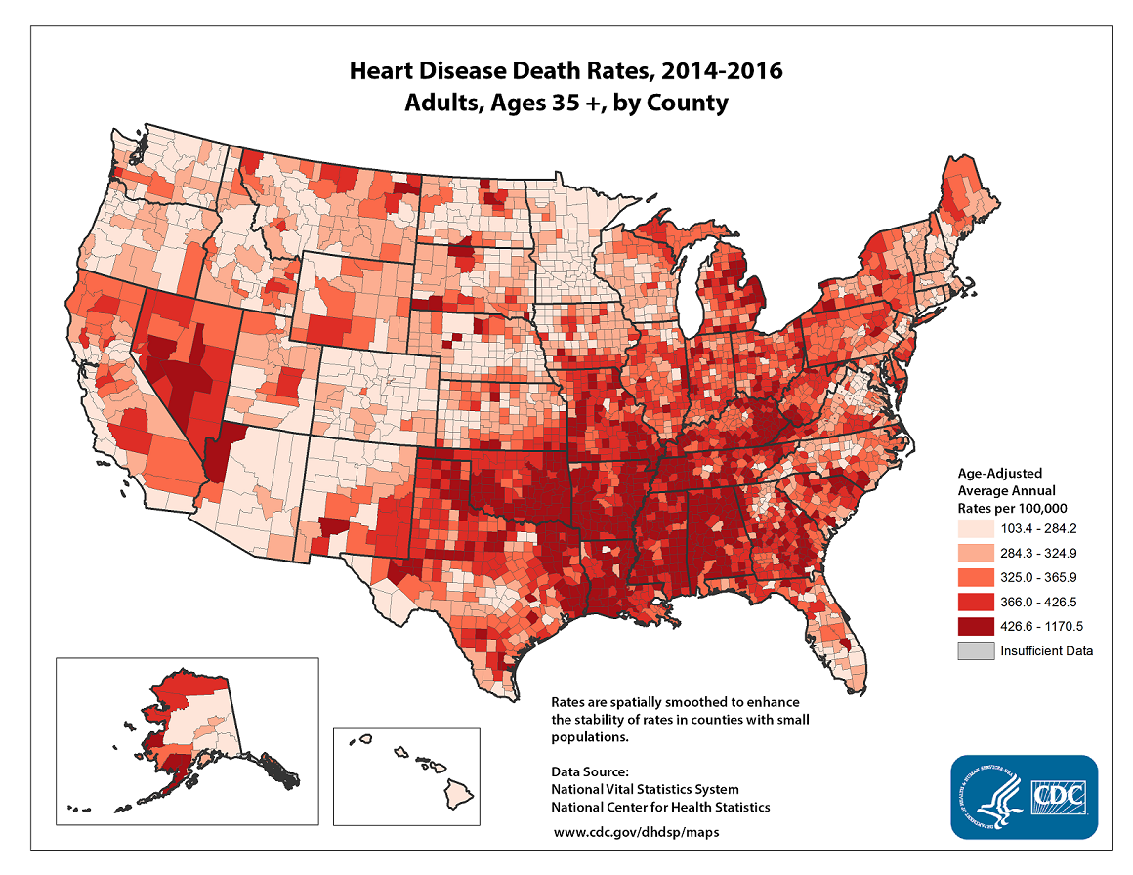
Data: Heart disease rates are lower in the Pacific Northwest
https://www.cdc.gov/heartdisease/facts.htm

Slide 11
Five Year Study
Supplementation of Vitamin D and/or Omega-3 oils did not reduce rates of heart disease or cancer. (https://www.npr.org/sections/health-shots/2018/11/10/666545527/vitamin-d-and-fish-oil-supplements-disappoint-in-long-awaited-study-results)
A separate meta-study shows inconclusive evidence that Vitamin D helps depression (https://www.ncbi.nlm.nih.gov/pmc/articles/PMC2908269/)

Slide 12

New Hypothesis
Spending more time outdoors is a common cause for elevated Vitamin D, lower depression, and better cardiac health.

Slide 13
Why Help in Online Communities?
Prestige
Reciprocity
Altruism
Build Reciprocal Relationships
Self Validation
Job Expectations
Learning

Slide 14
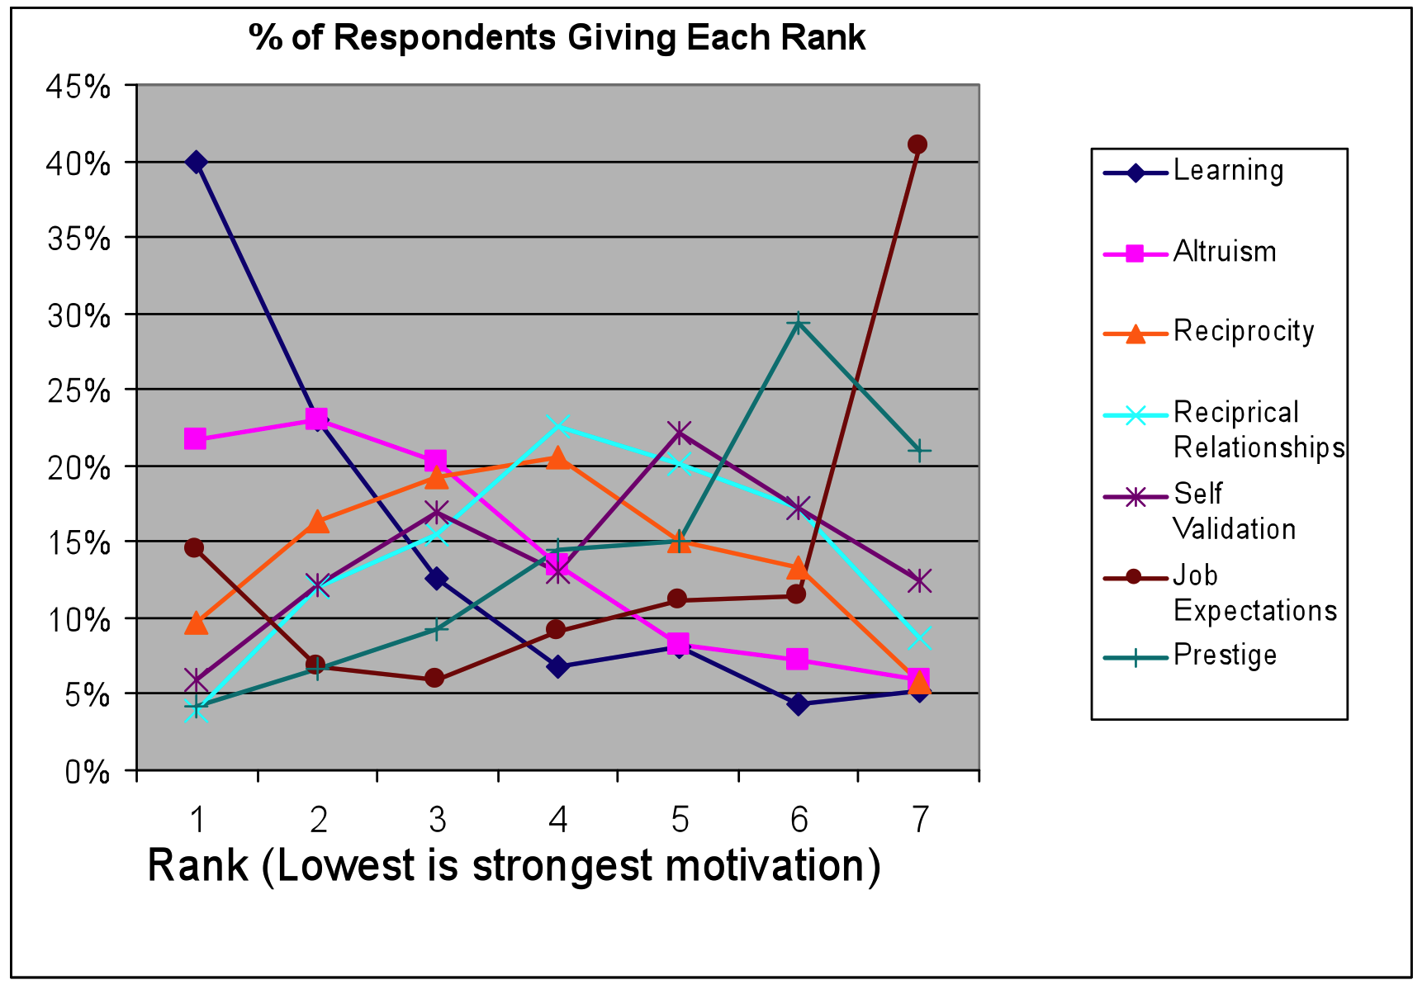
The Real Results….

Slide 15
Use the Right Measures
Top managers manage better because they measure better
Explore in problem-space to see if reliable, useful measures exist
Where good measures don’t exist, design your own measures
Notes:
Source: The Fog of War, Curtis Lemay.

Slide 16
Good measures are…
Simple (not complicated)
Firm performance? (simple would be by share price, or by earnings; not simple would be a mega formula that takes into account ROI, benchmarks, taxes and other external impacts, etc.)
Easily obtainable (collect/calculate)
How much you’ve learned in this course? (easy would be a test; not easy would be one on one interviews where we assess each major topic)
Precisely definable (you know, like stuff and things)
CEO Success (how would you define it?)

Slide 17


Business Intelligence vs. Business Analytics
Business Intelligence
the process and technology tools used to transform raw data into meaningful and useful information that support business decision making
Business Analytics
a subset of BI
the statistical analyses performed to help predict the future
Business
Analytics

Slide 18
Common BI & Analytics Contexts
Retail and sales: predicting sales, inventory levels, losses
Banking: forecasting bad loans, credit card fraud, consumer spending, consumer loan preferences
Operations: predicting machine failures, key influences of capacity
Insurance: forecasting claim amounts, coverage costs, consumer fraud and preferences
Law enforcement: predicting crime patterns, locations, criminal behavior, key influences of solving crimes
Airlines: predicting where customers want to fly and the ultimate destination of layover passengers (tells them where to add new hubs)
Health care: correlating the demographics of ill patients, predicting proper treatments and symptoms
Broadcasting: predicting what is the best time to air particular shows and advertisements
Marketing: classifying customer demographics that can be used to predict their preferences for various products
AND MANY MORE…

Slide 19
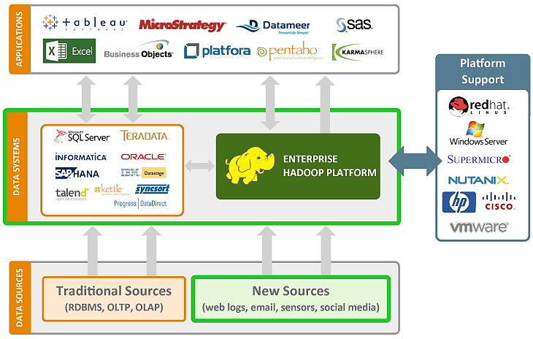


Display
Process
Source

Slide 20
Data Sources
RDBMS: Relational Database Management System
OLTP: Online Transaction Processing – For Business Operations
OLAP: Online Analytical Processing – For Business Intelligence
Internal Business Sources
Web Logs, Sensors, Instrumentation, Etc.
Online Data Sets
US Government
NCES: National Center for Education Statistics
BLS: Bureau of Labor Statistics
US Department of Commerce: Data and Reports
Organization for Economic Cooperation and Development (OECD)
Many Others: Google Dataset Search

Slide 21
Process: ETL (Extract/Transform/Load)
EXTRACT
Get the data out of the operational database (through queries)
Timing is an important consideration
TRANSFORM
Prepare the data for analysis
This includes “data cleaning” (different from data cooking)
Often includes completing data and summarizing data
LOAD
Paste prepped and cleaned data into the analytical database (data warehouse)

Slide 22

Process: Data Warehouse (Analytical Database)
A safe place to store current-enough data to be further queried, tampered with, and analyzed without affecting the original database
Because it is separate from the original database, tampering with it doesn’t affect your core business processes
Optimized for ad-hoc analyses
Hadoop can help build your data warehouse (among many other awesome features)
Click to watch
Notes:
The RIP is to remember to talk about how advances in processing capabilities and in RAM capacity may end up killing the DW (data warehouse). Queries can be run in realtime on raw data, with results dumping into local memory.

Slide 23
Process: Data Marts
Provide role-based views of the data
Reduce the amount of data the end user has to work with
Reduces threats to the data by providing limited access
Accounting
Human Resources
Marketing
Purchasing

Slide 24
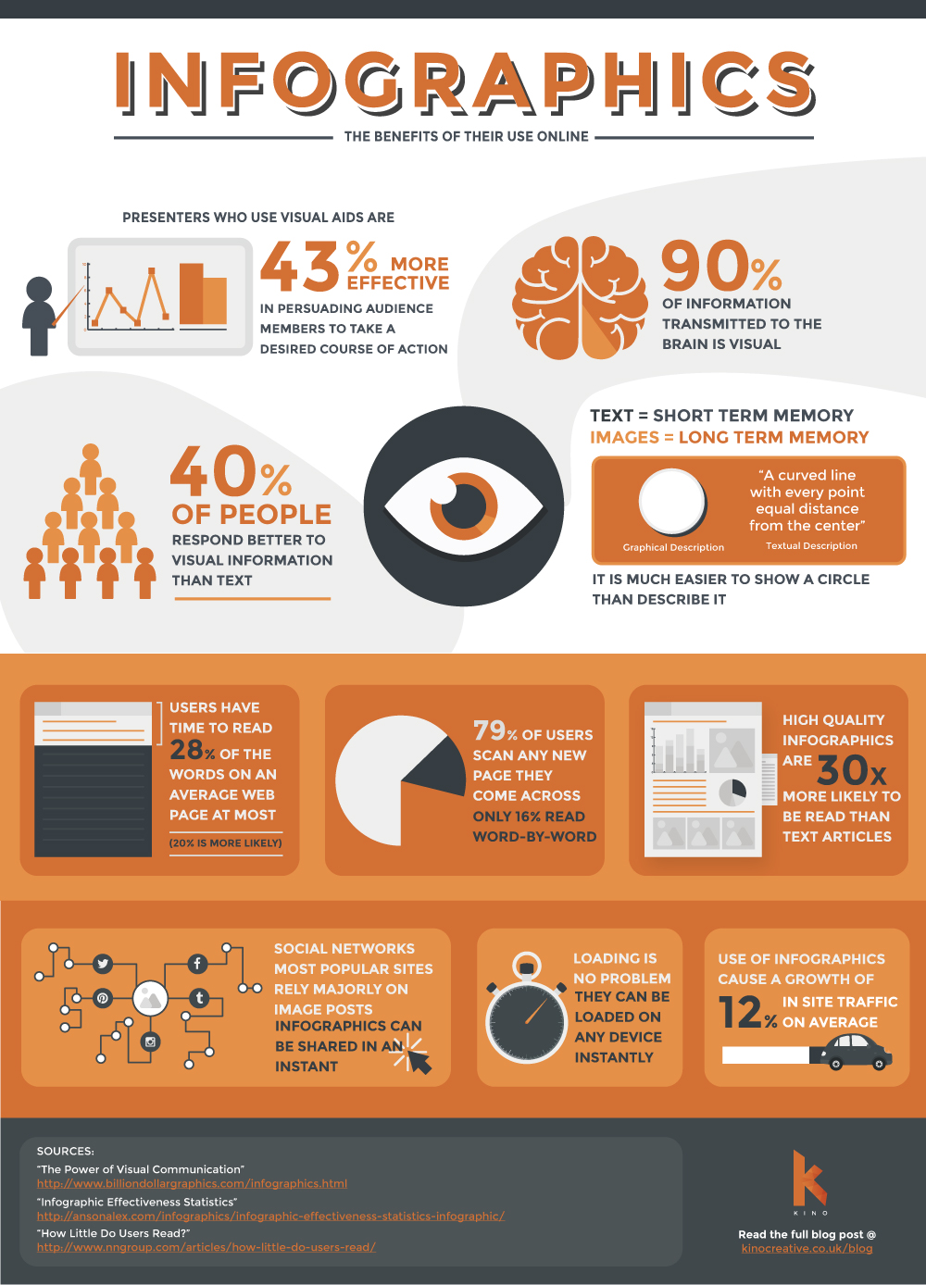
Display
Represent the data in a graphical or tabular way that makes it easy to make interpret the data accurately.
Transform from Data to Information

Slide 25
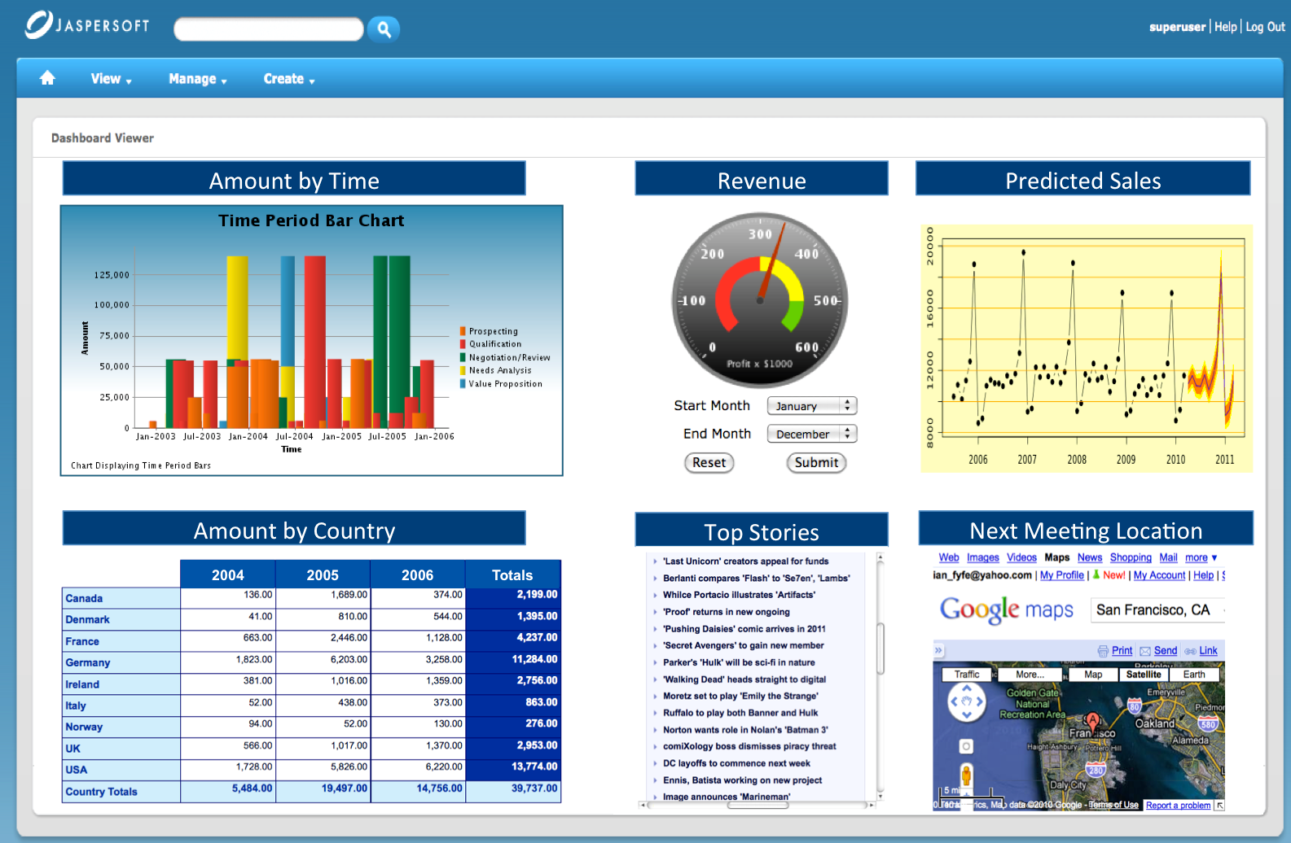
KPIs (Key Performance Indicators) visually presented using “dashboards”
KPI
OLAP Cube
Predictive Analytics
Notes:
The dashboard above (found at http://www.brainsins.com/en/blog/dashboard-for-e-commerce/2147) is likely used by a sales manager who is tracking the performance of their product line. There are several key components. First, notice the most important KPI to sales: revenue. Revenue is even depicted in automobile dashboard form (which is where the term "dashboard" came from). Second, notice the OLAP cube. OLAP stands for online analytical processing. OLAP cube is a common term used to describe the data table in the lower-left corner of the image above. Typically, the user can control the cube and change the dimensions that the data is summarized into. You'll learn to do something very similar (but on a much smaller scale) when you create Excel Pivot Tables in the next chapter. Third, notice that there is a prediction of future sales in the upper-right corner.

Slide 26
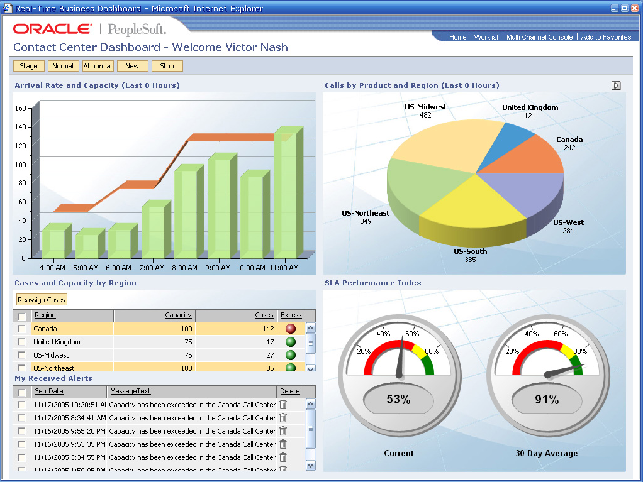
Descriptive Analytics
Call Center
Time and Location are front and center

Slide 27
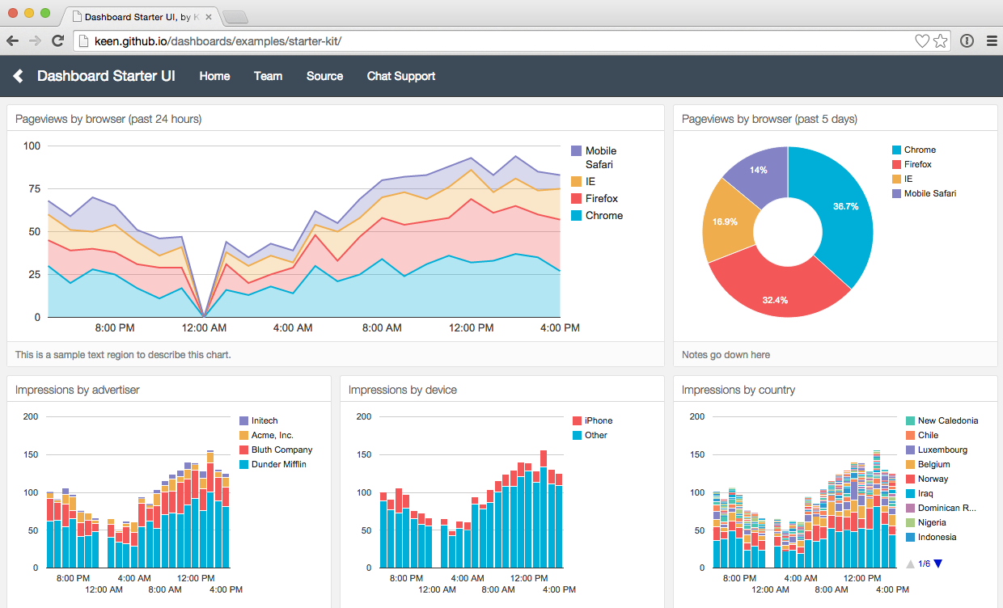
Descriptive Analytics
Call Center

Slide 28
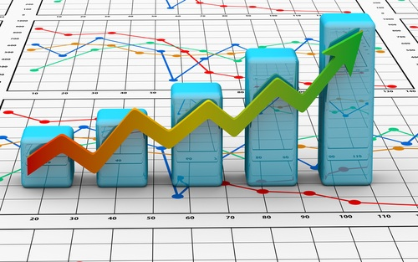
Predictive Analytics
You can use past and current data to predict future outcomes
Resource (e.g., employees) demand forecasts
Inventory forecasts
Sales forecasts
Traffic forecasts
Automated driving risk forecast
Notes:
Automated vehicles make cone forecasts (like storm projections) for every object in sight, so as to account for potential probable movement before it happens.

Slide 29
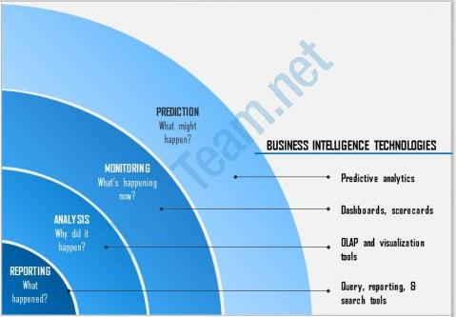
Prediction
What might happen?
BUSINESS INTELLIGENCE TECHNOLOGIES
Monitoring
What’s happening right now?
Predictive Analytics
Predictive Analytics
Dashboards, Scorecards
Dashboards, Scorecards
Analysis
Why did it happen?
OLAP, Visualization tools
OLAP, Visualization tools
Reporting
What happened?
Query, reporting, search tools
Notes:
Stuff gets more expensive and tricky the further you move toward the top right.

Slide 30
Summary Outline – Key Terms
Source
RDBMS – OLTP (Operational-Transactional Database)
Systems Logs, Sensors, Instrumentation, etc.
Data Mining
Process
ETL: Extract – Transform - Load
RDBMS – OLAP (Cube) (Analytical Database)
Data Warehouse
Data Lake
Data Mart
Time-Series Analysis
Data Cleaning / Scrubbing
Display
Key Performance Indicators (KPI)
Dashboards
Descriptive Analytics
Predictive Analytics

